Slide 1
React
Библиотека для создания пользовательских интерфейсов

Slide 2
Hello, world!
<div id="react-app"></div>
<script src="https://unpkg.com/react@16/umd/react.development.js"></script>
<script src="https://unpkg.com/react-dom@16/umd/react-dom.development.js"></script>
<script>
let rootElement = React.createElement(
'div',
{ style: { color: 'green' } },
'Hello, world!'
);
ReactDOM.render(
rootElement,
document.getElementById('react-app')
);
</script>

Slide 3
Сложные структуры элементов
let rootElement =
React.createElement('div', {},
React.createElement('h1', {}, "Contacts"),
React.createElement('ul', {},
React.createElement('li', {},
React.createElement('h2', {}, "Bill Gates"),
React.createElement('a', { href: 'mailto:bill@gates.com' }, 'bill@gates.com')
),
React.createElement('li', {},
React.createElement('h2', {}, "Steve Jobs"),
React.createElement('a', { href: 'mailto:steve@jobs.com' }, 'steve@jobs.com')
),
React.createElement('li', {},
React.createElement('h2', {}, "Jeff Bezos")
)
)
);
ReactDOM.render(rootElement, document.getElementById('react-app'));

Slide 4
Создание react элементов из данных
let contacts = [
{ name: 'Bill Gates', email: 'bill@gates.com' },
{ name: 'Steve Jobs', email: 'steve@jobs.com' },
{ name: 'Jeff Bezos' }
];
let contactElements = contacts.map(c => {
return React.createElement('li', { key: c.name },
React.createElement('h2', {}, c.name),
c.email != undefined
? React.createElement('a', { href: c.email }, c.email)
: null
)
});
let rootElement =
React.createElement('div', {},
React.createElement('h1', {}, "Contacts"),
React.createElement('ul', {}, contactElements)
);

Slide 5
Компонент Email
class Email extends React.Component {
render() {
return React.createElement(
'a',
{ href: this.props.value },
this.props.value
);
}
}

Slide 6
Компонент Contact
class Contact extends React.Component {
render() {
let emailElement;
if (this.props.email) {
emailElement = React.createElement(Email, { value: this.props.email });
}
return React.createElement('li', {},
React.createElement('h2', {}, this.props.name),
emailElement
);
}
}

Slide 7
Компонент App
class App extends React.Component {
render() {
let contactElements = this.props.contacts.map(c =>
React.createElement(Contact,
{
key: c.name,
name: c.name,
email: c.email
})
);
return React.createElement('div', {},
React.createElement('h1', {}, "Contacts"),
React.createElement('ul', {}, contactElements)
);
}
}

Slide 8
Приложение на компонентах
let contacts = [
{ name: 'Bill Gates', email: 'bill@gates.com' },
{ name: 'Steve Jobs', email: 'steve@jobs.com' },
{ name: 'Jeff Bezos' }
]
let rootElement = React.createElement(App, { contacts })
ReactDOM.render(rootElement, document.getElementById('react-app'));

Slide 9
Изменение данных и перерисовка
let contacts = [
{ name: 'Bill Gates', email: 'bill@gates.com' },
{ name: 'Steve Jobs', email: 'steve@jobs.com' },
{ name: 'Jeff Bezos' }
];
// first render
let rootElement = React.createElement(App, { contacts });
ReactDOM.render(rootElement, document.getElementById('react-app'));
// changing data
contacts[0].email = 'bill@mail.ru';
contacts.push({ name: 'Sergey Brin', email: 'sergey@brin.com' });
// render again
let nextRootElement = React.createElement(App, { contacts });
ReactDOM.render(nextRootElement, document.getElementById('react-app'));
Notes:
Сравнение по эвристически.
ReactElements with differing types are trashed and re-rendered
ReactElements with differing props or children are re-rendered in place
Identical ReactElements which have been re-ordered within an array are moved to reflect the new order

Slide 10
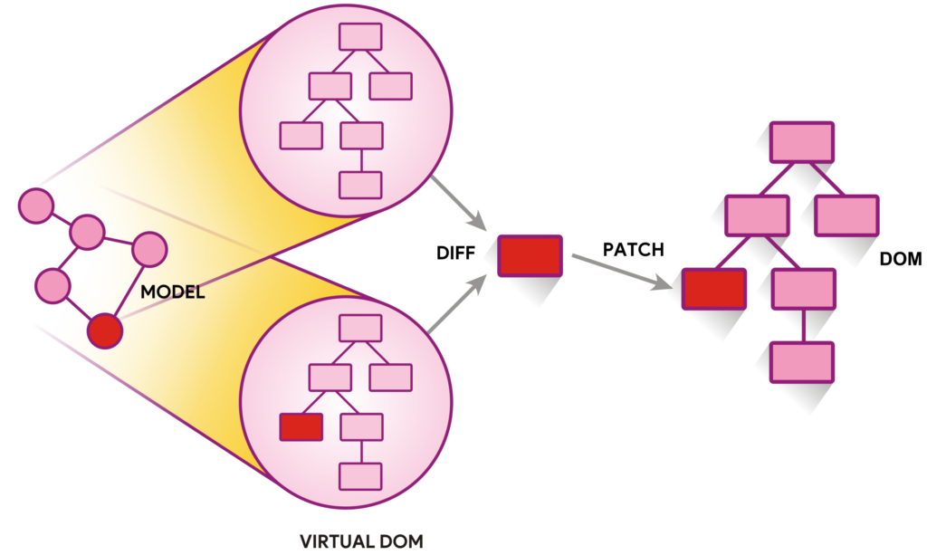
Как работает React

Slide 11
JSX синтаксис
let element = (
<div>
<h3>ToDo list</h3>
<ul>
<li>Learn JS</li>
<li>
Learn
<a href="https://reactjs.org">
React
</a>
</li>
</ul>
</div>
);
let element = React.createElement("div", {},
React.createElement("h3", {}, "ToDo list"),
React.createElement("ul", {},
React.createElement("li", {}, "Learn JS"),
React.createElement("li", {},
"Learn ",
React.createElement("a",
{ href: "https://reactjs.org" },
"React"
)
)
)
);
Слева код на JS, справа – аналог на JSX.

